Slide 1




Despicable me
Julien Brault
Margaux Hervouet
William Bri
World of Zuul
M1 Ghpy

Slide 2




Goal :
World of Zuul
Find the magic liquid and inject it into the bad minion
Notes:
William
2

Slide 3


Home page
Help
Start
Exit

Slide 4
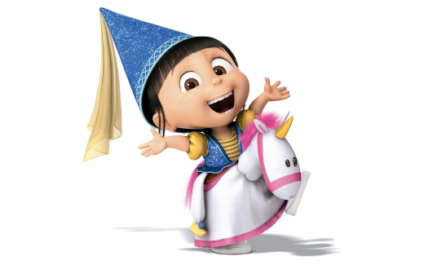
Welcome in the Despicable Me game !
Presentation of the main character.
Let me present you your character Agnes. She will accompany you in your adventure.
Let’s go!
1 000
NEXT

Slide 5


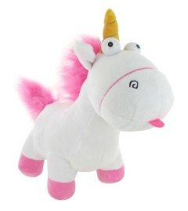
Agnes bedroom
Kitchen
Living room
Laboratory
Rocket
El Macho’s villa
Moon
Gru’s garden
By a friendly day of May, Agnes wakes up….
But she is finding that her unicorn is stollen…
She tries to find it everywhere in her bedroom, but there are no trace of it….
NEXT

Slide 6

Agnes bedroom
Kitchen
Living room
Laboratory
Rocket
El Macho’s villa
Moon
Gru’s garden
Help her to see her father in order to tell him what’s happen…
Click on the right doors in order to go to the kitchen….

Slide 7
Agnes bedroom
Kitchen
Living room
Laboratory
Rocket
El Macho’s villa
Moon
Gru’s garden
-100
Toilet
You’ve open the wrong door!
You are in the toilet!
You loose 100 points…
Please restart…
900
NEXT

Slide 8
Agnes bedroom
Kitchen
Living room
Laboratory
Rocket
El Macho’s villa
Moon
Gru’s garden
-100
Dressing
You’ve open the wrong door!
You are in the Dressing!
You loose 100 points…
Please restart…
800
NEXT

Slide 9
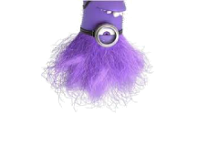
Agnes bedroom
Kitchen
Living room
Laboratory
Rocket
El Macho’s villa
Moon
Gru’s garden
-500
OH NO!! The bad minion scared Agnes!
You are in the bathroom!
You loose 500 points…
Please restart…
300
NEXT

Slide 10
Agnes bedroom
Kitchen
Living room
Laboratory
Rocket
El Macho’s villa
Moon
Gru’s garden
+100
Kitchen
Good job! You find the right door!
You can go to the Kitchen,
You win 100 points…
400
NEXT

Slide 11
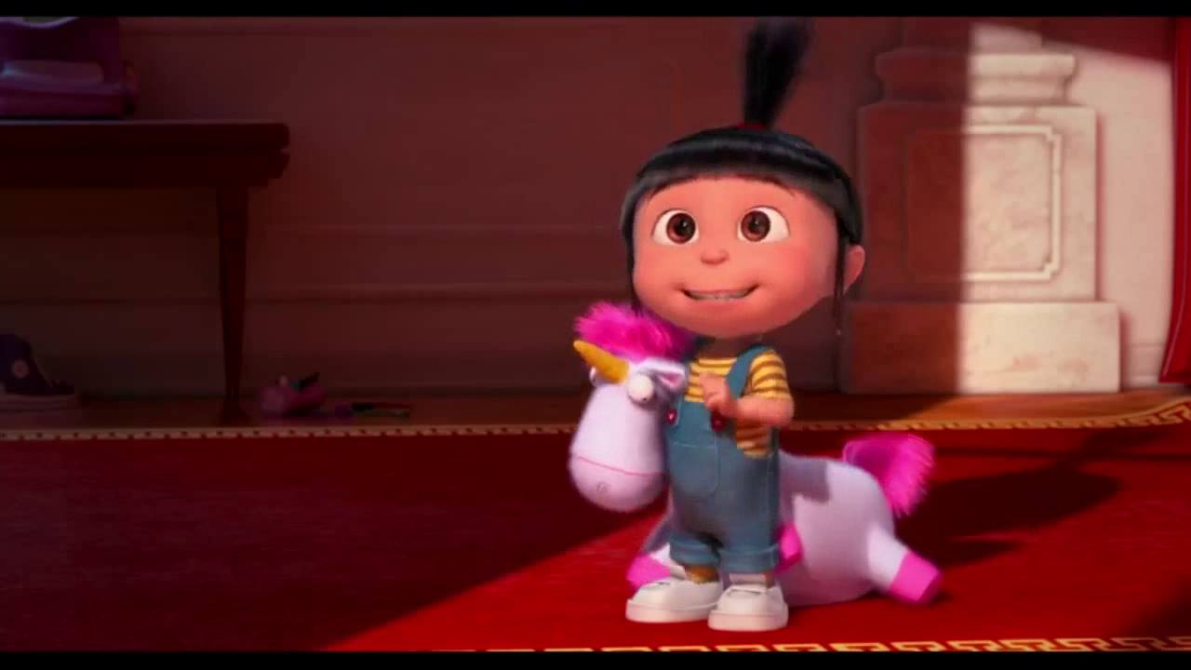
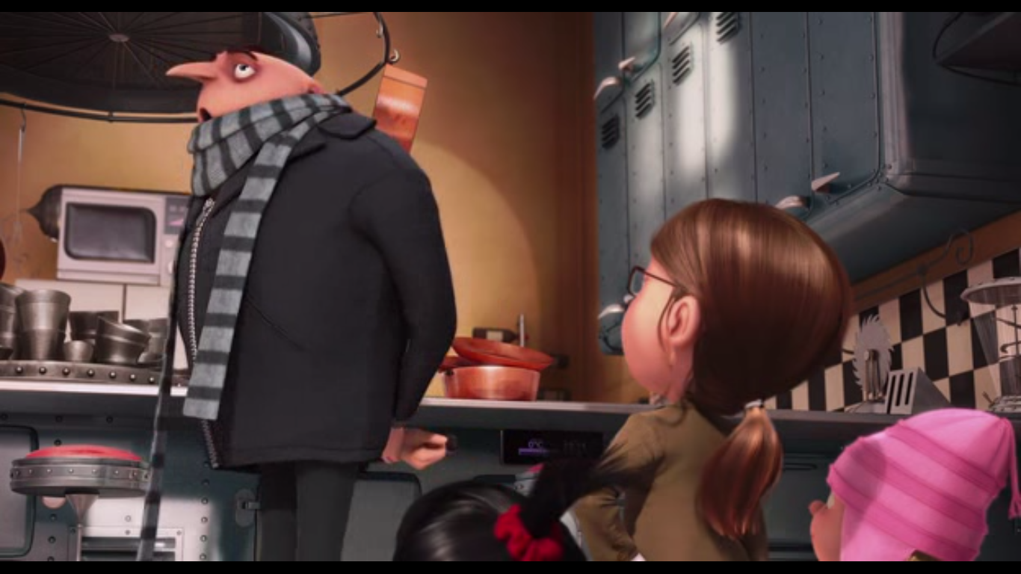
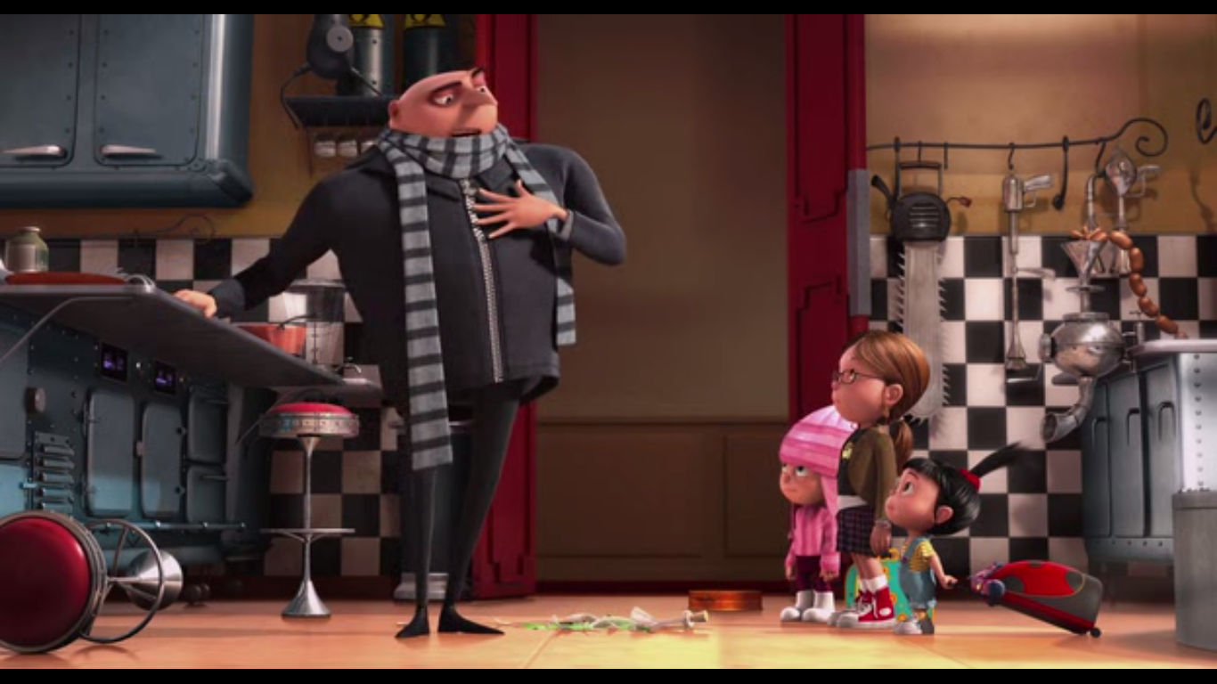
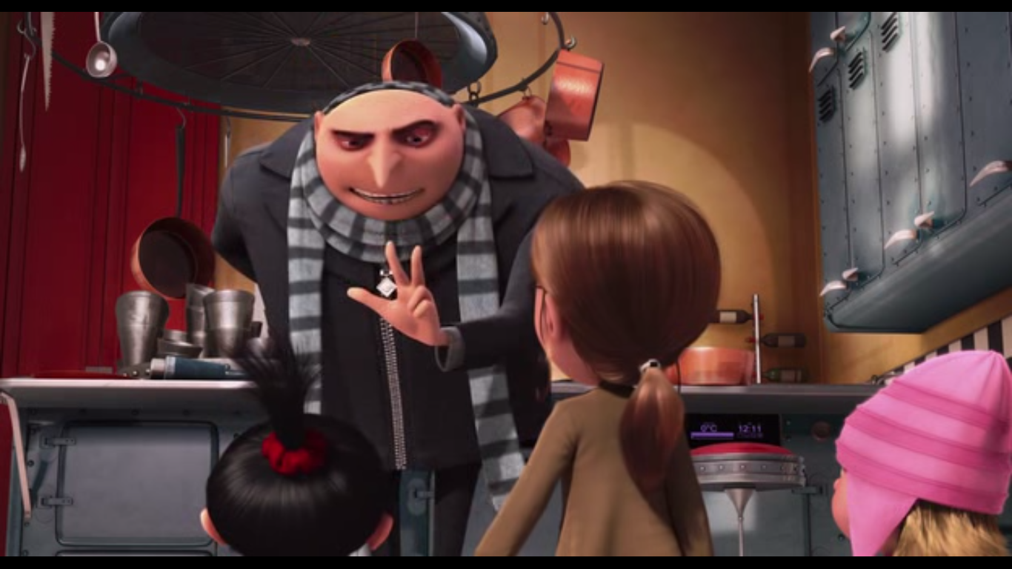
One of my many enemies, Senor El Macho, had captured one of our Minion. He lives with us at home, and basically it’s him who is in this kitchen and cooks.
Agnes bedroom
Kitchen
Living room
Laboratory
Rocket
El Macho’s villa
Moon
Gru’s garden
I’ve found my unicorn in the kitchen!! Thanks dad!
El Macho wants to afraid the population by transmorming my Minions; it’s why he was in your bedroom just before!! So we have to cure the bad Minion, and bring him home with us
Could you help me to bake a cake? Please find the sugar on these 3 cupboards
NEXT

Slide 12
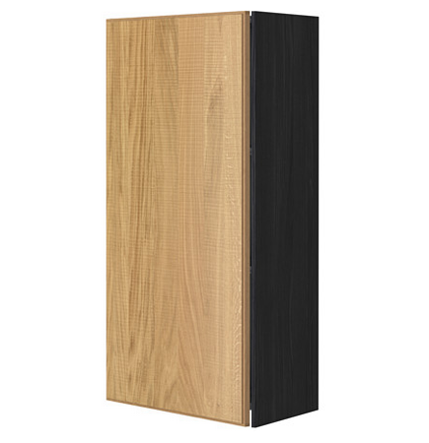
Agnes bedroom
Kitchen
Living room
Laboratory
Rocket
El Macho’s villa
Moon
Gru’s garden
Choose between this 4 cupboards

Slide 13

Agnes bedroom
Kitchen
Living room
Laboratory
Rocket
El Macho’s villa
Moon
Gru’s garden
Answer this question
Where was built the first subway ?
Tokyo
New York
Paris
London

Slide 14

Agnes bedroom
Kitchen
Living room
Laboratory
Rocket
El Macho’s villa
Moon
Gru’s garden
350
That’s wrong!
You loose 50 points…
Restart !
NEXT

Slide 15
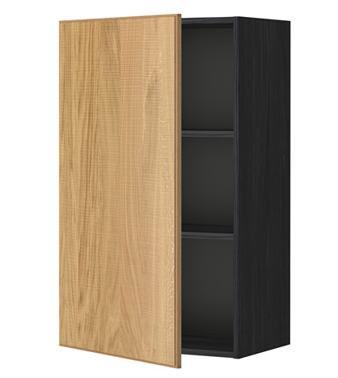

Agnes bedroom
Kitchen
Living room
Laboratory
Rocket
El Macho’s villa
Moon
Gru’s garden
250
That’s true! But the sugar is’nt in this cupboard…
You loose 100 points.
Please choose another one…
NEXT

Slide 16

Agnes bedroom
Kitchen
Living room
Laboratory
Rocket
El Macho’s villa
Moon
Gru’s garden
Answer this question
How many muscles we use when we smile ?
1
10
20
40

Slide 17
Agnes bedroom
Kitchen
Living room
Laboratory
Rocket
El Macho’s villa
Moon
Gru’s garden
200
That’s wrong!
You loose 50 points…
Restart !
NEXT

Slide 18

Agnes bedroom
Kitchen
Living room
Laboratory
Rocket
El Macho’s villa
Moon
Gru’s garden
300
That’s true! The sugar is in this cupboard…
You win 100 points.
NEXT

Slide 19

Agnes bedroom
Kitchen
Living room
Laboratory
Rocket
El Macho’s villa
Moon
Gru’s garden
We can go now to the next step!
Let’s go!
NEXT

Slide 20
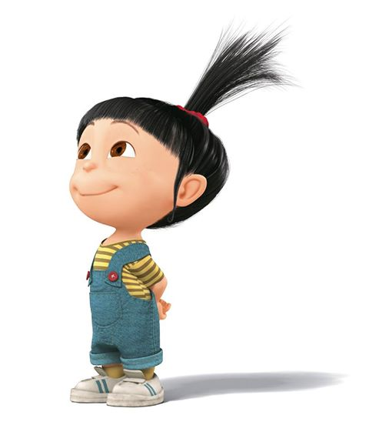
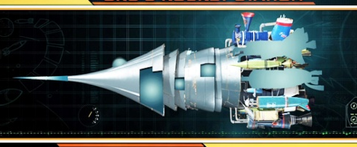
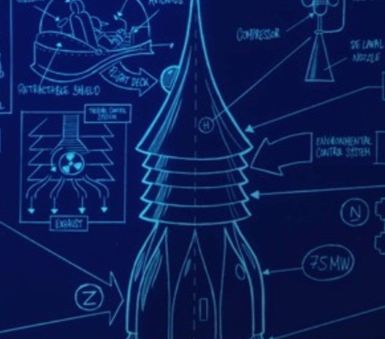
Now, Agnes wants to travel a little
Agnes bedroom
Kitchen
Living room
Laboratory
Rocket
El Macho’s villa
Moon
Gru’s garden
But, Agnes has something to do to start the rocket
NEXT

Slide 21

To start the rocket, you have to remember this sequence of numbers :
You have 10 secondes ...
Agnes bedroom
Kitchen
Living room
Laboratory
Rocket
El Macho’s villa
Moon
Gru’s garden
1 1 3 6 4 5 9 6 9 6

Slide 22
What is your answer ?
Agnes bedroom
Kitchen
Living room
Laboratory
Rocket
El Macho’s villa
Moon
Gru’s garden
NEXT

Slide 23
It’s not the right answer ...
You lose 100 points
You have two more trials !
Agnes bedroom
Kitchen
Living room
Laboratory
Rocket
El Macho’s villa
Moon
Gru’s garden
- 100 pts
NEXT

Slide 24
It’s still not the right answer ...
You lose 500 points
Agnes bedroom
Kitchen
Living room
Laboratory
Rocket
El Macho’s villa
Moon
Gru’s garden
- 500 pts
NEXT

Slide 25
What is your answer ?
Agnes bedroom
Kitchen
Living room
Laboratory
Rocket
El Macho’s villa
Moon
Gru’s garden
NEXT

Slide 26
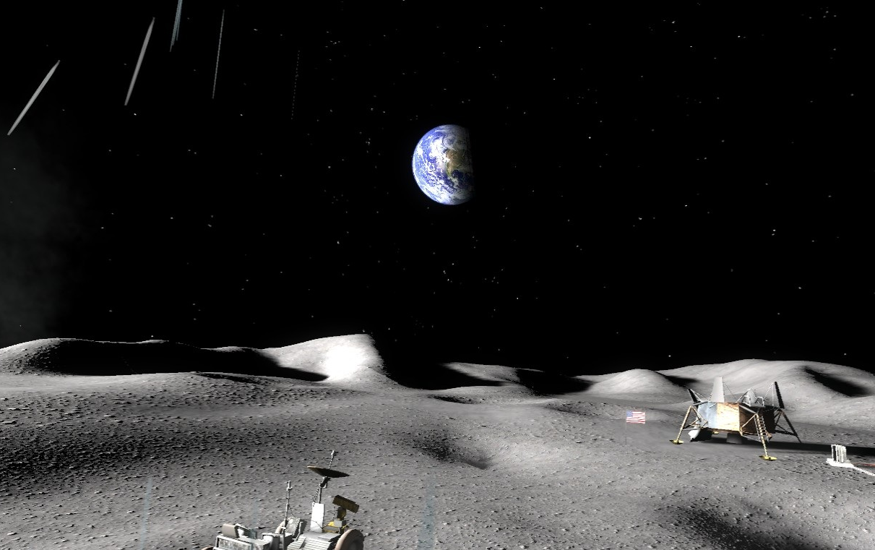




Hello Agnes, we have a problem with our rocket. If you want to come back to your house, you have to help us to repair the rocket ...
Agnes bedroom
Kitchen
Living room
Laboratory
Rocket
El Macho’s villa
Moon
Gru’s garden
Welcome to the moon !
NEXT

Slide 27

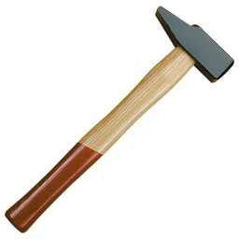
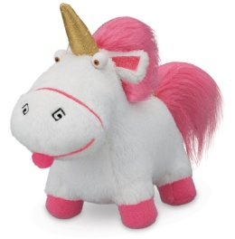


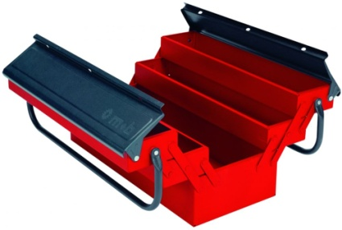


Click on the right tool
Agnes bedroom
Kitchen
Living room
Laboratory
Rocket
El Macho’s villa
Moon
Gru’s garden
Help me to choose the right tool !

Slide 28
It’s not the right tool, you lose 100 pts
Agnes bedroom
Kitchen
Living room
Laboratory
Rocket
El Macho’s villa
Moon
Gru’s garden
Are you serious ? A banana ?
- 100 pts
NEXT

Slide 29
Congratulations, it’s the right tool !
Agnes bedroom
Kitchen
Living room
Laboratory
Rocket
El Macho’s villa
Moon
Gru’s garden
Thank you ! Now I can help the Martians to repair their rocket and come back to my house !
NEXT

Slide 30
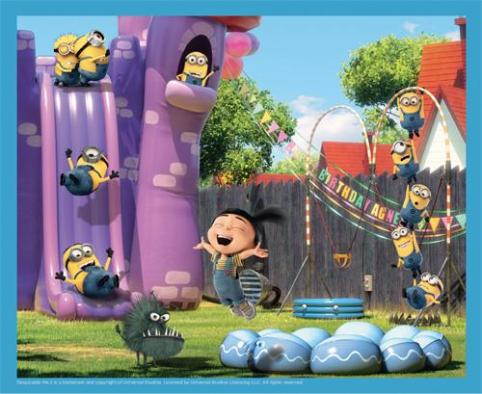
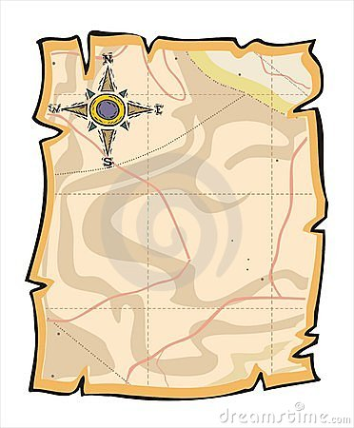

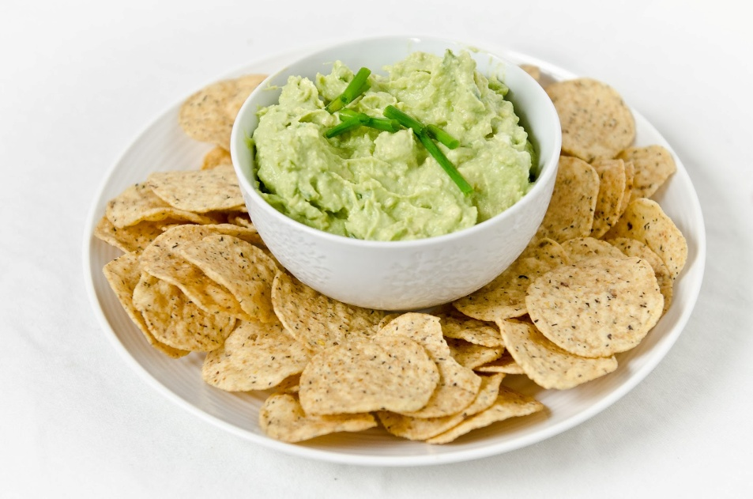
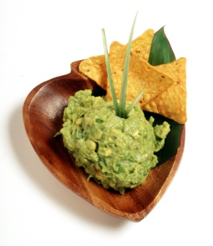
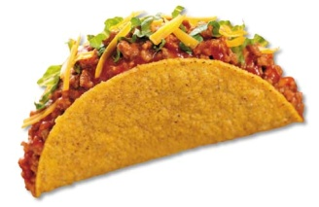
Agnes bedroom
Kitchen
Living room
Laboratory
Rocket
El Macho’s villa
Moon
Gru’s garden
With these clues, help Agnes to find where is the bad minion.
Click on the right place
Supermarket
Gru’s house
El Macho’s Vila
Waterpool

Slide 31
Agnes bedroom
Kitchen
Living room
Laboratory
Rocket
El Macho’s villa
Moon
Gru’s garden
- 200 pts
Supermarket ? No ! You lose 200 points
Try again. Click on the right place
Supermarket
Gru’s house
El Macho’s Vila
Waterpool

Slide 32
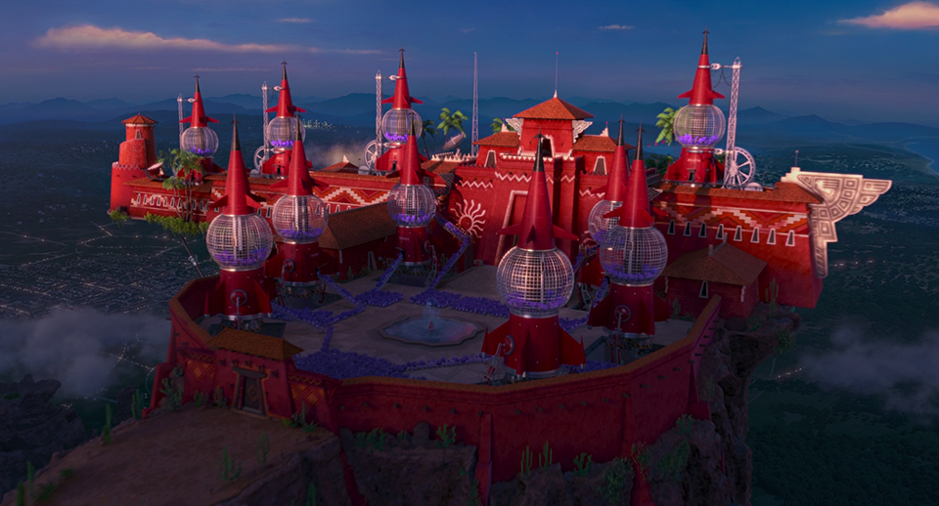
Agnes bedroom
Kitchen
Living room
Laboratory
Rocket
El Macho’s villa
Moon
Gru’s garden
Congratulations, the bad minion is in El Macho’s Villa !
NEXT

Slide 33
Agnes bedroom
Kitchen
Living room
Laboratory
Rocket
El Macho’s villa
Moon
Gru’s garden
The bad minion is behind one these doors, try to find the good one ...

Slide 34
Agnes bedroom
Kitchen
Living room
Laboratory
Rocket
El Macho’s villa
Moon
Gru’s garden
- 100 pts
You’ve open the wrong door!
You loose 100 points…
Please restart…

Slide 35
Agnes bedroom
Kitchen
Living room
Laboratory
Rocket
El Macho’s villa
Moon
Gru’s garden
CONGRATULATIONS ! You have found the bad minion !
You have just to click on him to inject the magic liquid

Slide 36

Agnes bedroom
Kitchen
Living room
Laboratory
Rocket
El Macho’s villa
Moon
Gru’s garden
Thank you to have played to our game !

Slide 37
Work completed :
World of Zuul
Main steps of the game
Map of the game
Code for each room of the game
Define it with their neighboor
Notes:
Here, we have put the map of the game, with the different places. When the user is in one place, he can return at the beginning each time, if his points are to zero. That’s why we have put one arrow from all the places to the bedroom. But the main way is like that, the bedroom to the kitchen, to the living room, to the laboratory, to the rocket in order to go to the moon, then to the garden and finally to El Macho’s Villa.
37

Slide 38
Work in progress :
World of Zuul
Begining of code
TD with Julien Dambrine (doors and rooms)
Notes:
Here, we have put the map of the game, with the different places. When the user is in one place, he can return at the beginning each time, if his points are to zero. That’s why we have put one arrow from all the places to the bedroom. But the main way is like that, the bedroom to the kitchen, to the living room, to the laboratory, to the rocket in order to go to the moon, then to the garden and finally to El Macho’s Villa.
38

Slide 39
Work remaining :
World of Zuul
Specifications for each room
Possibility to ask some questions to the user
Define how we can interact with the machine
Notes:
Here, we have put the map of the game, with the different places. When the user is in one place, he can return at the beginning each time, if his points are to zero. That’s why we have put one arrow from all the places to the bedroom. But the main way is like that, the bedroom to the kitchen, to the living room, to the laboratory, to the rocket in order to go to the moon, then to the garden and finally to El Macho’s Villa.
39

Slide 40

World of Zuul
Thank you for your attention
Notes:
Margaux
40

